Slide 2
Week 1
Introduction
Module overview

Slide 3


Meet Larry…

Slide 4
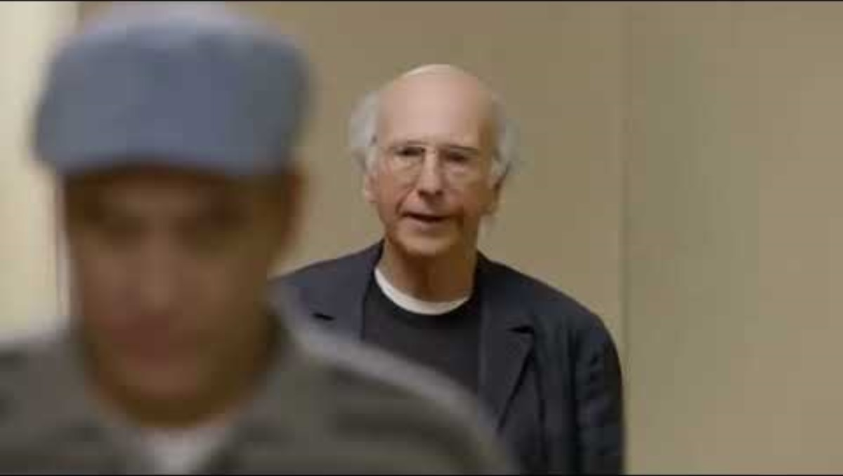
Notes:
L: I calculated your speed, my speed, the distance, my average urination time;
And according to my calculations, I would have had to wait 3 to 4 minutes, where you only had to wait 12-15 seconds;
I think it was the right move

Slide 5
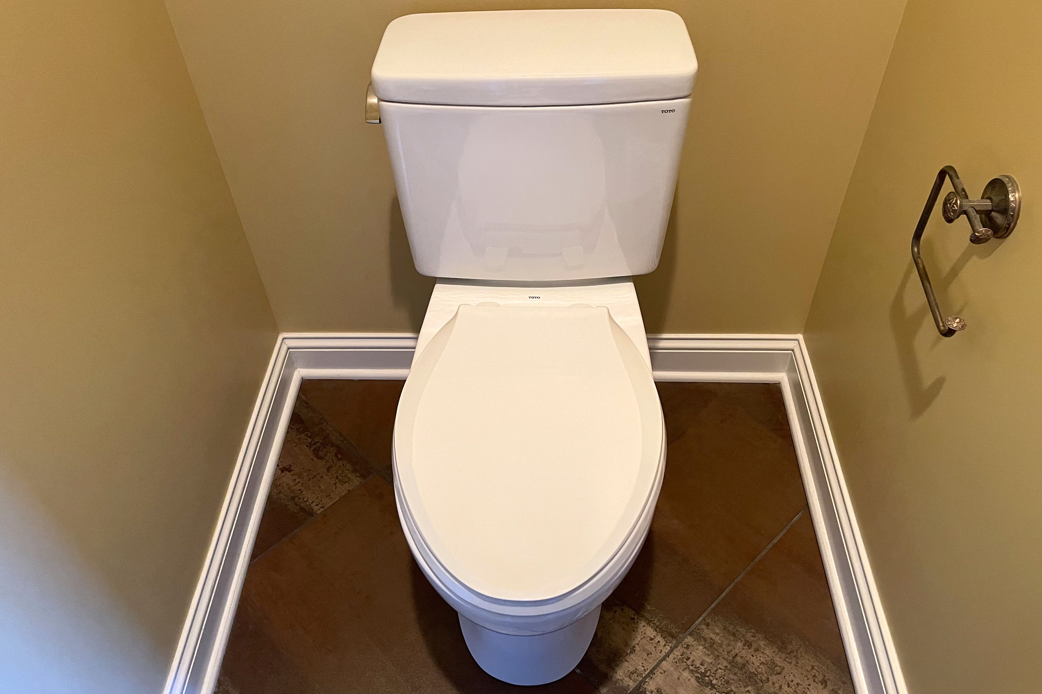
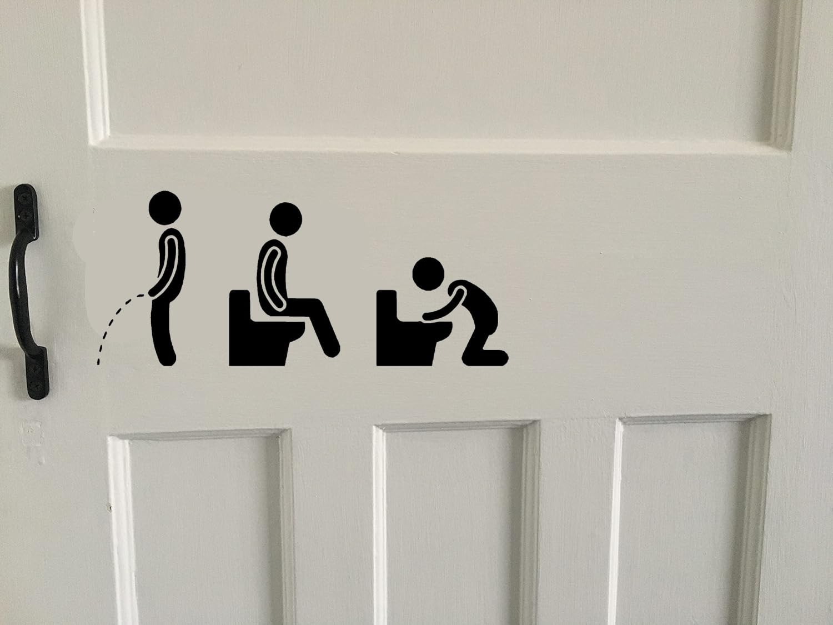
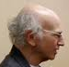
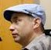
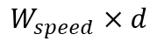
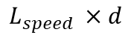
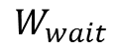
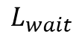
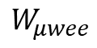
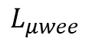
Deconstructing Larry
“I calculated your speed, my speed, the distance, my average urination time; and according to my calculations, I would have had to wait 3 to 4 minutes, where you only had to wait 12 to 15 seconds. I think it was the right move
”
$$L_{μwee}$$
$$W_{μwee}$$
$$L_{wait}$$
$$W_{wait}$$
$$L_{speed }×d$$
$W_{speed}×d$
Larry
Wally
Notes:
L: I calculated your speed, my speed, the distance, my average urination time;
And according to my calculations, I would have had to wait 3 to 4 minutes, where you only had to wait 12-15 seconds;
I think it was the right move

Slide 6
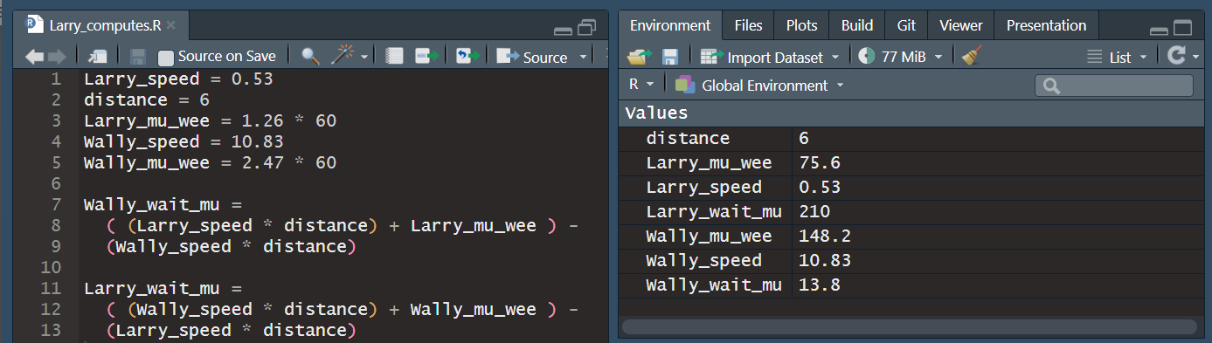
Deconstructing Larry
$$L_{μwee}$$
$$W_{μwee}$$
$$L_{wait}$$
$$W_{wait}$$
$$L_{speed }×d$$
$W_{speed}×d$
Larry
Wally
Notes:
L: I calculated your speed, my speed, the distance, my average urination time;
And according to my calculations, I would have had to wait 3 to 4 minutes, where you only had to wait 12-15 seconds;
I think it was the right move

Slide 7
Deconstructing Larry
Notes:
L: I calculated your speed, my speed, the distance, my average urination time;
And according to my calculations, I would have had to wait 3 to 4 minutes, where you only had to wait 12-15 seconds;
I think it was the right move

Slide 8
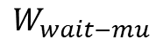
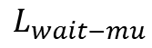
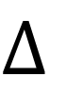
Deconstructing Larry
$$L_{wait−mu}$$
$$W_{wait−mu}$$
210 13.8
$$Δ$$
Larry
Wally
Notes:
L: I calculated your speed, my speed, the distance, my average urination time;
And according to my calculations, I would have had to wait 3 to 4 minutes, where you only had to wait 12-15 seconds;
I think it was the right move

Slide 9
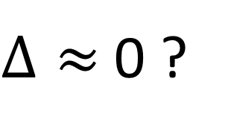
Deconstructing Larry
$$L_{wait−mu}$$
$$W_{wait−mu}$$
210 13.8
$Δ≈$0 ?
Larry
Wally
Notes:
L: I calculated your speed, my speed, the distance, my average urination time;
And according to my calculations, I would have had to wait 3 to 4 minutes, where you only had to wait 12-15 seconds;
I think it was the right move

Slide 10

Modelling
Computation
Reproducibility
Application

Slide 11
Modelling
Computation
Reproducibility
Application
Linear models
Generalised linear models
Interaction models
Multilevel models
Causal models
Longitudinal models

Slide 12






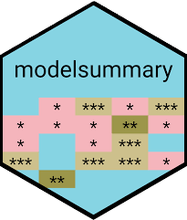



Modelling
Computation
Reproducibility
Application
Notes:
“Computation” – or … “coding”?
Most generally, this means that we will be using computer programs throughout. Specifically, we will be using the R computing environment / statistical programming language, and we will be using it in the RStudio IDE (Integrated Development Environment), which provides a great deal of additional convenience functionalities. These make coding and programming in R a lot more user-friendly, although the sheer volume of options and features can make it somewhat intimidating at first (and second, and third…).
While Rstudio basically integrates the R console interface with a bunch of other features, there are many “packages” that extend the R programming language itself with additional functions.

Slide 13











Modelling
Computation
Reproducibility
Application
+
code.R
+
text+code.Rmd
text.md
text+code.qmd
other languages:
various text editors:
…
Notes:
Working with code script files in R (e.g. “code.R”) increases the reproducibility of research.
Working with plain text files (e.g. in the “markdown” markup language) similarly ensures that whatever we write is in a format that will last and can be accessed by anyone; separation between the text and manual formatting is key;
Special markdown that combines text and R code (“R Markdown”);
“Quarto” (and the .qmd format) a more recent development mean to be a standalone tool that allows multiple programming languages and can be implemented in a variety of plain text/code editors;
and, of course, can be used within the Rstudio IDE, in fact it comes pre-installed and completely integrated in relatively recent versions

Slide 14
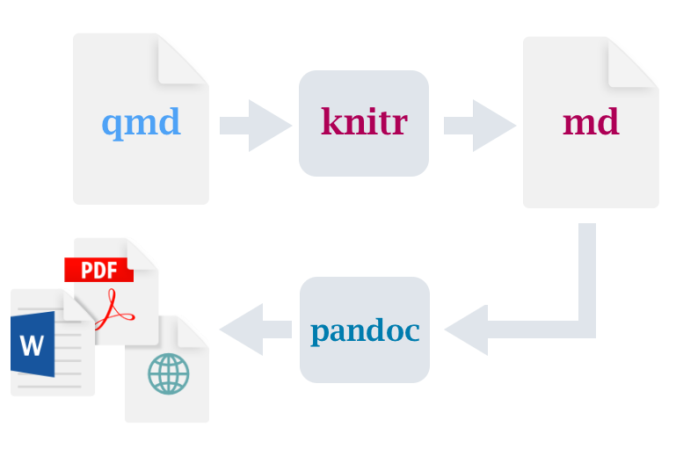
Modelling
Computation
Reproducibility
Application
+
code.R
+
text+code.Rmd
text.md
text+code.qmd
other languages:
various text editors:
…
Notes:
Working with code script files in R (e.g. “code.R”) increases the reproducibility of research.
Working with plain text files (e.g. in the “markdown” markup language) similarly ensures that whatever we write is in a format that will last and can be accessed by anyone; separation between the text and manual formatting is key;
Special markdown that combines text and R code (“R Markdown”);
“Quarto” (and the .qmd format) a more recent development mean to be a standalone tool that allows multiple programming languages and can be implemented in a variety of plain text/code editors;
and, of course, can be used within the Rstudio IDE, in fact it comes pre-installed and completely integrated in relatively recent versions

Slide 15
Modelling
Computation
Reproducibility
Application
Akaeda (2023) “Trust and the Educational Gap in the Demand for Redistribution: Evidence from the World Values Survey and the European Value Study”. International Sociology 38(3): 290–310
Dawson (2019) “How Persistent Is Generalised Trust?” Sociology 53(3): 590–99
Dingemans and Van Ingen (2015) “Does Religion Breed Trust? A Cross-National Study of the Effects of Religious Involvement, Religious Faith, and Religious Context on Social Trust”. Journal for the Scientific Study of Religion 54(4):739–55
Kumove (2024) “Take Five? Testing the Cultural and Experiential Theories of Generalised Trust Against Five Criteria”. Political Studies
Mitchell (2021) “Social Trust and Anti-immigrant Attitudes in Europe: A Longitudinal Multi-Level Analysis”. Frontiers in Sociology 6: 604884
Österman (2021) ”Can We Trust Education for Fostering Trust? Quasi-Experimental Evidence on the Effect of Education and Tracking on Social Trust”. Social Indicators Research 154(1):211–33
Wilkinson and Pickett (2010) “Income Inequality and Trust”, in Chapter 4 of The Spirit Level: Why Greater Equality Makes Societies Stronger. New York: Bloomsbury Press
Wu (2021) “Education and Social Trust in Global Perspective”. Sociological Perspectives 64(6):1166–86

Slide 16
Modelling
Computation
Reproducibility
Application
Akaeda (2023) “Trust and the Educational Gap in the Demand for Redistribution: Evidence from the World Values Survey and the European Value Study”. International Sociology 38(3): 290–310
Dawson (2019) “How Persistent Is Generalised Trust?” Sociology 53(3): 590–99
Dingemans and Van Ingen (2015) “Does Religion Breed Trust? A Cross-National Study of the Effects of Religious Involvement, Religious Faith, and Religious Context on Social Trust”. Journal for the Scientific Study of Religion 54(4):739–55
Kumove (2024) “Take Five? Testing the Cultural and Experiential Theories of Generalised Trust Against Five Criteria”. Political Studies
Mitchell (2021) “Social Trust and Anti-immigrant Attitudes in Europe: A Longitudinal Multi-Level Analysis”. Frontiers in Sociology 6: 604884
Österman (2021) ”Can We Trust Education for Fostering Trust? Quasi-Experimental Evidence on the Effect of Education and Tracking on Social Trust”. Social Indicators Research 154(1):211–33
Wilkinson and Pickett (2010) “Income Inequality and Trust”, in Chapter 4 of The Spirit Level: Why Greater Equality Makes Societies Stronger. New York: Bloomsbury Press
Wu (2021) “Education and Social Trust in Global Perspective”. Sociological Perspectives 64(6):1166–86

Slide 17
Modelling
Computation
Reproducibility
Application
Akaeda (2023) “Trust and the Educational Gap in the Demand for Redistribution: Evidence from the World Values Survey and the European Value Study”. International Sociology 38(3): 290–310
Dawson (2019) “How Persistent Is Generalised Trust?” Sociology 53(3): 590–99
Dingemans and Van Ingen (2015) “Does Religion Breed Trust? A Cross-National Study of the Effects of Religious Involvement, Religious Faith, and Religious Context on Social Trust”. Journal for the Scientific Study of Religion 54(4):739–55
Kumove (2024) “Take Five? Testing the Cultural and Experiential Theories of Generalised Trust Against Five Criteria”. Political Studies
Mitchell (2021) “Social Trust and Anti-immigrant Attitudes in Europe: A Longitudinal Multi-Level Analysis”. Frontiers in Sociology 6: 604884
Österman (2021) ”Can We Trust Education for Fostering Trust? Quasi-Experimental Evidence on the Effect of Education and Tracking on Social Trust”. Social Indicators Research 154(1):211–33
Wilkinson and Pickett (2010) “Income Inequality and Trust”, in Chapter 4 of The Spirit Level: Why Greater Equality Makes Societies Stronger. New York: Bloomsbury Press
Wu (2021) “Education and Social Trust in Global Perspective”. Sociological Perspectives 64(6):1166–86

Slide 18
Modelling
Computation
Reproducibility
Application
Assignment
Include (a) either an appendix with the R code used to analyse the data, (b) inline R code produced from an RMarkdown/Quarto document, or (c) submit the RMarkdown/Quarto document separately as an additional file
The code and code comments do not count towards the wordcount

